Slide 1
Embedding InfoSec Lifecycle Into SDLC
The systems development life-cycle (SDLC) should embed the Information Security activities forming a sec-SDLC (secure SDLC)

Slide 2
Embedding InfoSec Lifecycle Into SDLC
1. Requirements
2. Assess Current Posture
3. Remediation Plan
4. Implement Controls
5. Test/Validate
6. Accredit
7. Monitor & Audit
***FORMAL BUSINESS LAUNCH OR GO-LIVE
INFORMATION
SECURITY
LIFECYCLE

Slide 3
Embedding InfoSec Lifecycle Into SDLC
Software Assurance Maturity Model (SAMM) developed by OWASP
A guide to building security into software development
96 page PDF
http://www.opensamm.org/downloads/SAMM-1.0.pdf

Slide 4

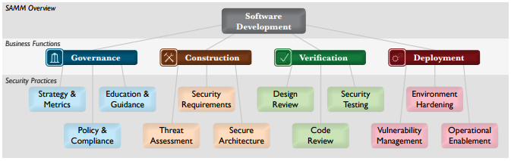
Embedding InfoSec Lifecycle Into SDLC

Slide 5
Embedding InfoSec Lifecycle Into SDLC
Four critical business functions
For each business function there are three security practices
For each security practice, three maturity levels as objectives
http://www.opensamm.org/downloads/SAMM-1.0.pdf (PAGE 3)

Slide 6
Embedding InfoSec Lifecycle Into SDLC
The Software Assurance Maturity Model (SAMM) is an open framework to help organizations formulate and implement a strategy for software security that is tailored to the specific risks facing the organization.
http://www.opensamm.org/downloads/SAMM-1.0.pdf (PAGE 3)

Slide 7
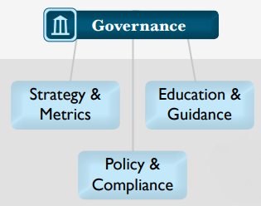
Embedding InfoSec Lifecycle Into SDLC

Slide 8
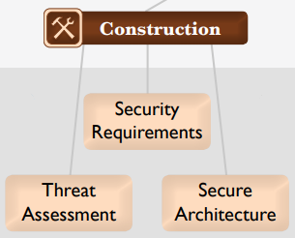
Embedding InfoSec Lifecycle Into SDLC

Slide 9
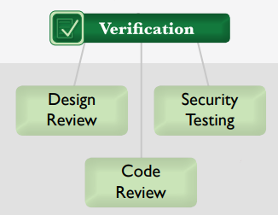
Embedding InfoSec Lifecycle Into SDLC

Slide 10
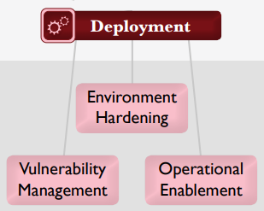
Embedding InfoSec Lifecycle Into SDLC

Slide 11
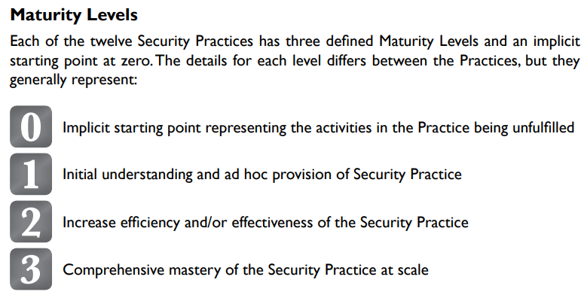
Embedding InfoSec Lifecycle Into SDLC

Slide 12
Embedding InfoSec Lifecycle Into SDLC
The SAMM document sections:
Understanding the model
Applying the model
Security practices
Case studies
http://www.opensamm.org/downloads/SAMM-1.0.pdf
END

